Slide 1

Diocese of San Diego
Safe Environment Training
12th Grade

Slide 2
Christian Love
1 Corinthians 13 teaches us to identify healthy and loving relationships.
Love is…
  Patient
  Kind
  Not Jealous, pompous, inflated or rude
  Not self-centered, quick-tempered, or holds grudges
Notes:
State: Let us examine those qualities of Christian love listed in 1 Corinthians 13 that can help form healthy, loving relationships.
Love is…
Patient
Kind
Not Jealous, pompous, inflated or rude
Not self-centered, quick-tempered, or holds grudges

Slide 3
Christian Love
Every human is created with love in the image and likeness of God.
We owe respect to each person as 1 Corinthians 13 teaches us.
Without the love described in Corinthians, we are like a “clashing cymbal”, lots of noise with little substance.
Notes:
Summarize: Every human is created in the image and likeness of God. Because of that, we owe each person the respect demonstrated by the characteristics of Christian love described in 1 Corinthians 13. Without this love, scripture tells us we are like a “clashing cymbal” that makes a lot of noise, but has little substance.

Slide 4

Types of Christian Love
Compassionate
Familial
Trusting
Romantic
Marital
Notes:
State: : God created people to love. There are many different types of love. There is compassionate love for those who are homeless or hungry or ill. There is familial love for parents, brothers, sisters, aunts, uncles. There is a trusting love for very best friends. There is romantic love for someone you date. There is also marital love for the person you are married to. Each type of love has physical, non-physical and emotional components. These components serve as boundaries for the type of relationship you are in.

Slide 5
Compassionate Love
Types of Love/Emotions/Attitudes
Compassionate
  Extended to all people
Physical and Non-Physical Expressions
  Handshake
  Words of care
  Sharing resources
  Respect
Notes:
State: Compassionate love is extended to all people. Appropriate expressions of this love include:
Handshakes
Words of Care
Sharing of resources
Respect

Slide 6
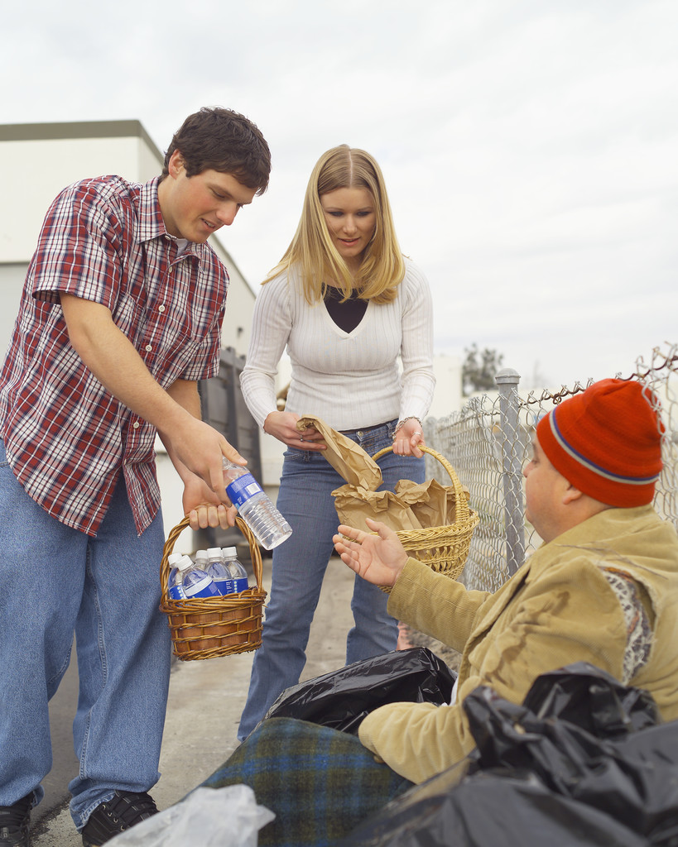

Slide 7
Familial Love
Types of Love/Emotions/Attitudes
Familial
  Parents and Siblings
  Some extended family members
Physical/Non-physical expressions:
  Hugs
  Play
  Non-romantic kiss
  Help
  Kindness
Notes:
State: Familial love is experienced with family. Appropriate expressions of this love include:
Hugs
Play
Non-romantic kissing
Help
Kindness

Slide 8


Slide 9
Trusting Love
Types of Love/Emotions/Attitudes
Trusting
  Close friends
Physical/Non-physical expressions:
  Hugs
  Sharing confidences & feelings
  Affection
Notes:
State: Trusting love is most likely experienced with close friends. Appropriate expressions of this love include:
Hugs
Sharing confidences and feelings
Affection

Slide 10


Slide 11
Romantic Love
Types of Love/Emotions/Attitudes
Romantic
  Dating
Physical/Non-physical expressions:
  Hugs
  Holding Hands
  Encouragement
  Esteem
Notes:
State: Romantic Love is experienced in dating relationships. Appropriate expressions of this love include:
Hugs
Holding hands
Mutual encouragement
Esteem

Slide 12


Slide 13
Marital Love
Types of Love/Emotions/Attitudes
Married
  Husband and Wife
Physical/Non-physical expressions:
  Hugs
  Kisses
  Sexual love
  Generosity
  Joy and Respect
Notes:
State: Marital love is found in married couples. Appropriate expressions of this love include:
hugs
kisses
sexual love
generosity
joy
respect

Slide 14


Slide 15
Love and Relationships
Some expressions for each type of love may overlap but there are safeguards or “boundaries” for each.
Each category may have its own feelings of affection, fear, anger, joy or even guilt but, boundaries establish the rules.
Boundaries help to appropriately communicate or share thoughts, attitudes and feelings.
Notes:
State: Some of the expressions may seem to overlap the various categories of love, but there are safeguards which maintain and protect appropriate and inappropriate expressions of love for each. Those safeguards or rules for relationships are called boundaries. For example, in each of the categories there may be feelings of affection, fear, joy, anger and even guilt, but boundaries serve to establish the rules that define how to appropriately communicate or share those thoughts, attitudes, or feelings.

Slide 16


Slide 17
Sexual Love
Genesis teaches us that God intended sexual love between a married man and a woman for a distinct purpose.
Sexual love is an image of the absolute and unfailing love of God for humankind.
God is relational and desires our communion with him.
God’s love is free, total, faithful and fruitful.
The proper place and context for sexual love is within a marriage, man and woman as a total gift of self to the other, a life generating union.
Notes:
State: Genesis teaches us that God intended sexual love between a married man and a woman for a distinct purpose.
“God created man in his image; in the divine image he created him; male and female he created them. God bless them, saying: ‘Be fertile and multiply; fill the earth and subdue it.” And in the second account of creation in Genesis 2:23-24: “When he brought her to the man, the man said: “This one, at last, is bone of my bones and flesh of my flesh; This one shall be called ‘woman,’ for out of ‘her man’ this one has been taken. That is why a man leaves his father and mother and clings to his wife, and the two of them become one body.”
Sexual love is an image of the absolute and unfailing love with which God loves human beings. God passionately desires that people live in relationship with him. God’s love is free, total, faithful and fruitful.
The proper place for sexual love is found only within marriage where a union between a man and a woman is formed. It is the proper context in which each spouse gives to the other his or her total self, a love that generates union and new life.

Slide 18


Slide 19
Love and Relationships
Based on the purpose of sexual love…
  sexual contact outside of marriage lacks the total gift of a man and woman to each other.
Without a permanent commitment…
  there is a lack of freedom to love each other completely or be faithful.
It lacks…
  The generosity and sacrificial care needed to assume responsibility for the care of children.
Notes:
State: Based on the purpose of sexual love, sexual contact outside of marriage lacks the total gift of a man and a woman to each other. Without a permanent commitment, there is a lack of freedom to love the other completely or to be faithful. It lacks the generosity and sacrificial care needed to assume responsibility for the care of children. Therefore, sexual expressions of love find their rightful place in the marriage relationship only.

Slide 20
What makes a Healthy Relationship?
Mutual Respect
Trust
Honesty
Support
Good Communication
Notes:
State: But before we even get to marriage it is important to develop healthy relationships. Let’s talk about what makes a healthy relationship:
Healthy relationships enjoy:
Mutual Respect
Trust
Honesty
Support
Good Communication

Slide 21
Mutual Respect
Mutual Respect:
  Values the other person and enjoys the differences that exist.
  Respects each other’s friends, activities and point of view.
  One person does not dominate the other or attempt to control them.
  1 Corinthians says, Love is patient and kind.
Notes:
Mutual Respect: In a healthy relationship each person values who the other is and enjoys those differences. You respect each other’s friends, activities and point of view. If you have a different point of view, you respect that. One person does not dominate the other or try to control them. Remember, 1 Corinthians says, Love is patient and kind.

Slide 23
Trust
Trust:
There must be trust in one another, if trust is absent, the relationship will not be a healthy one.
Manipulation can harm trust in a relationship.
Jealousy is also another form of mistrust, this has no part in a relationship.
1 Corinthians says, Love is not jealous pompous, inflated or rude.
Notes:
Trust: There’s no way you can have a healthy relationship if you don’t trust each other. Trust can be harmed if someone tries to manipulate or coerce you to do something that you are not comfortable doing or that is harmful to you. Jealousy, a form of mistrust, has no part in a healthy relationship. Remember, 1 Corinthians says, Love is not jealous pompous, inflated or rude.

Slide 25
Honesty
Honesty:
It is difficult to trust someone when honesty is not present.
Feel free to be who you are and say what you think.
Conforming to another person’s wishes is being dishonest to yourself.
1 Corinthians says, Love is not self-centered.
Notes:
Honesty: It’s hard to trust someone when honesty is not present. You both should feel free to be who you are and say what you think. Conforming to the other person’s wishes in order to please someone is being dishonest to yourself. Remember, 1 Corinthians says, Love is not self-centered.

Slide 26
Support
Support:
A healthy relationship calls for mutual support through good times and bad times.
Listening, offering encouragement and showing concern are essential.
Support is not to be confused with agreeing with someone who may hurt him/herself or others.
1 Corinthians says, Love is not self-centered.
Notes:
Support: In a healthy relationship, both persons are called to help each other through good times and bad times. Listening, offering encouragement, and showing concern are strong elements of support. Do not confuse this with agreeing with someone who may be doing something to hurt himself or herself. Remember, 1 Corinthians says, Love is not self-centered.

Slide 27


Slide 28
Good Communication
Good Communication:
Ask what another person means by what s/he says and/or means.
Be honest and open to avoid misunderstandings.
Never keep feelings bottled up.
1 Corinthians says, Love is not quick tempered and does not hold grudges or focuses on the things others do against us.
Notes:
Good Communication: You may not always know what another person means by what he or she says. It’s important to ask if you’re not sure what he or she means. Speak honestly and openly so that misunderstanding is avoided in the first place. Never keep feelings bottled up.

Slide 29


Slide 30
What makes a Healthy Relationship?
Healthy relationships should be enjoyable.
Include a variety of friends.
Relationships should make you feel good about yourself.
Although misunderstandings happen even in healthy relationships, the feeling of happiness and satisfaction should outweigh difficult moments.
Notes:
State: So as you can see healthy relationships should be enjoyable. Try to include a variety of friends. These relationships should make you feel good about yourself. Although there may be misunderstandings and hurt feelings at times, the effort it takes to maintain the relationship should generally leave both people feeling a sense of happiness and satisfaction. These are internal indicators of a healthy relationship.

Slide 31


Slide 32
Unhealthy Relationships
A relationship is unhealthy when it involves behavior that:
  Demands
  Belittles
  Disrespects
  Manipulates
  Controls
  Physically/Sexually abuses another person
Notes:
State: Unfortunately we must also learn to protect ourselves from unhealthy relationships. A relationship is unhealthy when it involves behavior that demeans, belittles, disrespects, manipulates, controls, or physically/ sexually abuses another person. Let us look at a few types of abuse.

Slide 33
Types of Abuse
Physical Abuse
Sexual Abuse
Emotional (verbal) abuse:
Bullying
Notes:
State: Types of abuse can be categorized into:
Physical Abuse
Sexual Abuse
Emotional Abuse
Bullying
Any of these actions do not belong in a healthy relationship.

Slide 34
Physical Abuse
Any kind of following constitutes physical abuse:
  Biting
  Choking
  Throwing
  Beating
  Hitting
  Shaking
  Burning
  Pinching
  And any other actions that cause physical injury, leave marks or produce significant physical pain.
Notes:
State: Physical Abuse is any kind of hitting, shaking, burning, pinching, biting, choking, throwing, beating, and other actions that cause physical injury, leave marks, or produce significant physical pain.

Slide 35
Sexual Abuse
Sexual Abuse is:
Any type of sexual contact between an adult and anyone younger than 18.
Between a significantly older child and a younger child.
Any one person who overpowers another regardless of age.
Notes:
State: Sexual Abuse is any type of sexual contact between an adult and anyone younger than 18; between a significantly older child and a younger child; or if one person overpowers another, regardless of age.

Slide 36
Emotional Abuse
Emotional (verbal) Abuse:
Emotional abuse is not only yelling or expressing anger towards another.
Emotional abuse entails:
  Belittling
  Blaming
  Demeaning
  Constantly criticizing
  Threatening
  Dismissing another
  Emotional abuse is abuse.
Notes:
State: Emotional or verbal abuse can occur not only by yelling and expressing anger at another. It involves behavior that belittles, blames, demeans, constantly criticizes, threatens, manipulates or dismisses another. It treats another without respect wounding another’s sense of self worth. Emotional abuse is abuse.

Slide 38
Bullying
Bullying:
A form of abuse.
Includes:
  Intimidation
  Threats
  Humiliation
Notes:
State: Bullying is a form of abuse. It includes bullying someone through intimidation, threats, or humiliation

Slide 39
Abuse
Remember it is always the fault of the abuser
Despite the shame or guilt the victim might feel, the abuser is always responsible for the abuse.
Notes:
State: Remember that any of these forms of abuse are always the fault of the abuser and never the fault of the victim. Sometimes a victim feels shame or blames oneself: “How could I put myself in that position to be used? I must have done something to encourage the abuse. I feel so ashamed, I can’t tell anyone.” It is critical to soundly dismiss these statements. One might feel shame or guilt, but it is NEVER the victim’s fault because the abuser is always responsible for the abuse. If you or one of your friends is a victim of abuse tell a parent or trusted adult until the abuse stops.

Slide 40
Warning Signs of Sexual Abuse
Isolation
Emotional Changes
Constant Communication
Jealousy
Excuses
Loss of Self Image
Lack of Respect for Physical Boundaries
Notes:
The final part of this lesson will talk about how to protect yourself from sexual abuse. These are some warning signs to be aware of:
Isolation
Emotional Changes
Constant Communication
Jealousy
Excuses
Loss of Self Image
Lack of Respect for Physical Boundaries

Slide 41
Warning Signs of Sexual Abuse
Isolation:
  Abuser keeps victim away from friends and family.
Emotional Change:
  Sadness, depression, indecisiveness, fear
Constant Communication:
  Abuser constantly calls or texts victim when not with him/her
Jealousy:
  Abuser makes threats about the relationship
Notes:
Isolation: Abuser keeps victim away from friends and family as much as possible.
Emotional Changes: While in the relationship you experience sadness, depression, indecisiveness, fear.
Constant Communication: When not with the victim, the abuser is constantly calling or texting to see what the victim is doing.
Jealously: Abuser makes threats about the relationship if the victim spends time with others.

Slide 42
Warning Signs of Sexual Abuse
Excuses:
  Victim makes excuses for abusive behavior, taking blame for abuser’s actions of anger or jealousy.
Loss of Self-Image:
  Victim feels bad about self. Physical appearance may reflect the internal pain.
Lack of Respect for Physical Boundaries:
  Deterioration of respect for boundaries. Abuser touches victim without consent in genital areas, makes suggestive sexual comments or shows pornography.
Notes:
Excuses: the victim frequently makes excuses for the abusive behavior, often taking the blame for the abuser’s anger or jealousy.
Loss of Self Image: the victim feels bad about himself or herself. Physical appearance may change to please the abuser or may look unkept to reflect the internal pain.
Lack of Respect for Physical Boundaries: the victim suffers gradual deterioration of respect for boundaries; the abuser touches the person without his or her consent; the abuser touches genital areas of the person’s body; the abuser makes suggestive statements about the other person’s body, about sexual activity, or shows pornography.

Slide 43
Strategies for Responding to Abusive Situations/Relationships
Stay Safe:
  Avoid going to private places, stop all communication such as phone calls, IM, texts, emails, anything.
Get support/help:
  Parents should be your first choice, but if you feel that is not a good place to start, go to a school counselor, teacher, catechist or any other trusted adult.
  Your parents, under ordinary circumstances, will need to be advised of the situation. A trusted adult can help you approach your parents, if needed.
Notes:
If you feel that you or a friend are in danger of being abused, respond by following these strategies. Above all, talk to a parent or trusted adult until the abusive situation or behavior stops.
Stay Safe- do not go to a private place with this person. Stop all communication with that person: screen phone calls, no emails, IM, anything
2. Get support and help- Friends are a wonderful way to get support for your difficult situation. However, it is crucial that you speak with a parent and or trusted adult about this situation. Your parents are the first choice, but if you feel that is not a good place to start, go to a school counselor, teacher, catechist, priest, anyone whom you feel would be able to help you to be safe. Your parents, under ordinary circumstances, will need to be advised of the situation. A trusted adult can help you to approach your parents, if needed.

Slide 44
Responding to Abuse
If you are a victim of abuse:
  If sexual abuse has taken place, it needs to be reported immediately to parents, trusted adults and law authorities.
  Do not confront the abuser.
If you believe your friend is being abused:
  Share your concerns, don’t wait for your friend to approach you.
  Ask your friend to listen and enumerate as many warning signs of abuse.
  When your friend asks you to listen believe what he/she says.
Call Reinforcements:
  Do not keep this a secret.
  Seek help; be persistent and talk to a parent or trusted adult.
Notes:
State: if sexual abuse has taken place, it needs to be reported immediately to parents, trusted adults, and law authorities. Do not confront the abuser.
If you believe one of your friends is a victim of abuse, speak out and share your concerns. Do not wait for your friend to tell you. Ask him/her to listen to your concerns. Identify as many warning signs of abuse as possible that you have observed. When you friend asks you to listen to what is said, believe him/her.
Call in reinforcements. This is not a secret you should keep. Encourage your friend to go with you, but even if he or she refuses, go yourself. Talk to your parents or trusted adult about what you know. Be persistent in finding some adult who can help stop the abusive situation.

Slide 45
Get Help
Abusers seek to gratify their needs.
They will use various means of manipulation to control and get what they want.
Once you identify signs of abuse in your life, seek help from parents or trusted adults.
Dealing with an abuser is not easy.
Although you are almost adults, abusers use skills that can fool even adults.
Remember to reach out to a trusted adult at the first signs of abuse.
Notes:
State: Be aware that abusers only seek to gratify their needs. Although they may appear friendly or helpful, they will use various means of power and control to get what they want from you. When you recognize warning signs of abuse in your life or with someone you know, seek help from parents and trusted adults until the abuse stops.
It is important to recognize that dealing with an abuser is not easy. Even though you are almost adults, the skills an abuser uses can even fool an adult. If a friend or you find yourself in a situation where there are signs of sexual abuse, you need to find a trusted adult to talk to. Continue to tell your concerns to a trusted adult until the circumstances or abusing person’s behavior no longer continue.

Slide 46
You are a Gift from God
The most important thing to remember is that you are a gift from God deserving of respect.
Relationships should be enjoyable and fun.
Relationships should include a wide variety of friends.
Good friendships and family relationships should include the qualities of Christian love.
Notes:
State: The most important thing is to remember that you are a gift from God deserving of respect. Relationships should be enjoyable and fun. They should include a wide variety of friends. Good friendships and family relationships should include the qualities of Christian love.

Slide 48

This presentation was created with permission by using the Archdiocese of Galveston-Houston’s Sacred and Safe Lesson Plans.

