Slide 1
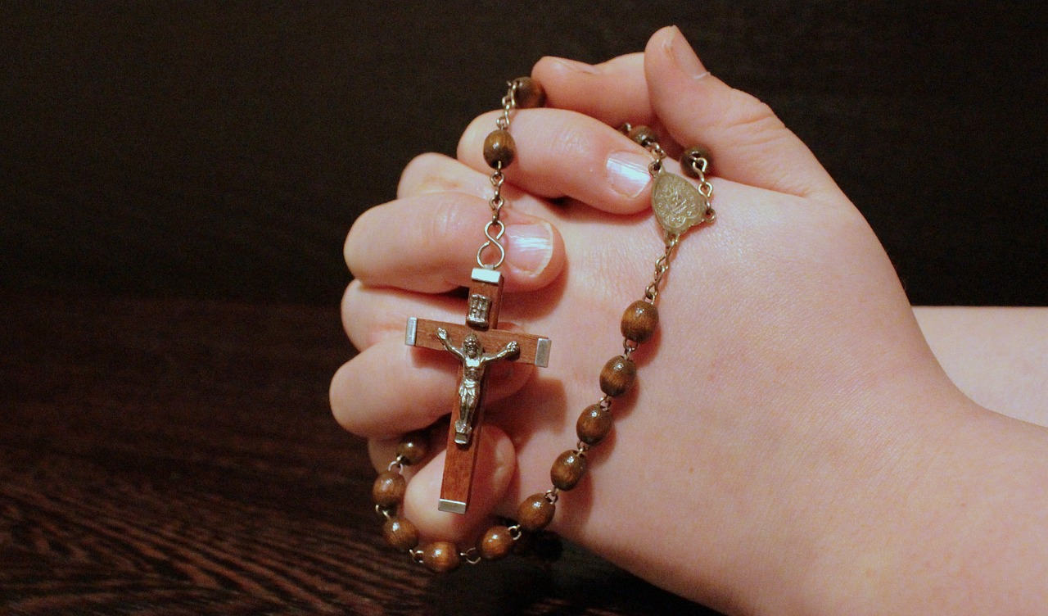
ROSARY MEDITATIONS FOR
A SYNODAL CHURCH

Slide 2
THE GLORIOUS MYSTERIES

Slide 3
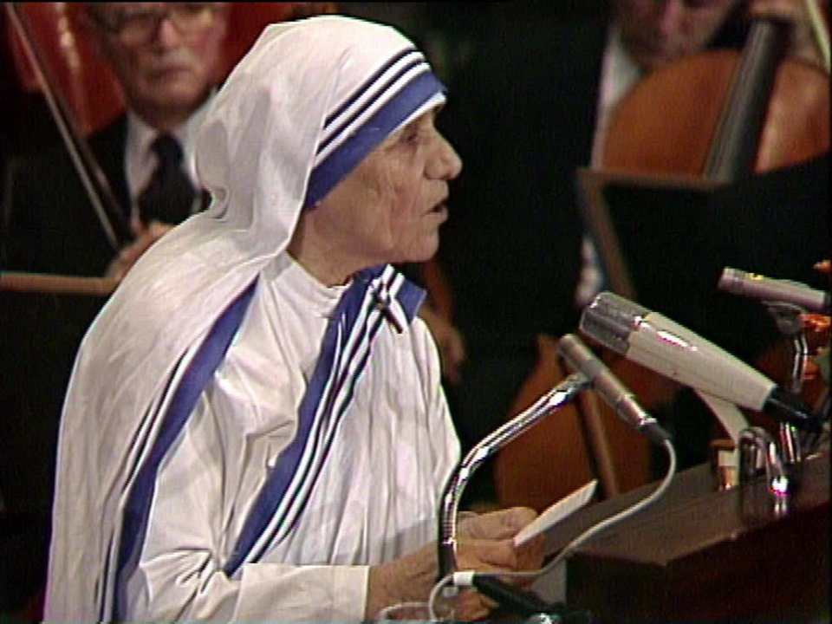
The First Glorious Mystery:
The Resurrection of Jesus Christ
Dear Lord,
your disciples listened to Mary Magdalene announce the Gospel, the Good News of your resurrection. May the Church today listen to women announce the Gospel.
A synodal church is a particular church when active involvement in the church is nurtured.
Matthew 28:1-8
Mary Magdalene and the other Mary came to see the tomb…an angel of the Lord descended from heaven and said to the women … “Do not be afraid! I know that you are seeking Jesus the crucified. He is not here, for he has been raised just as he said … go quickly and tell his disciples …” Then they went away quickly from the tomb, fearful yet overjoyed, and ran to announce this to his disciples.

Slide 4
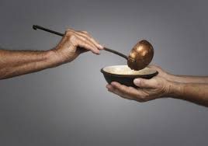
The Second Glorious Mystery:
The Ascension of Jesus to Heaven
Dear Lord, give us the grace to listen carefully to your Great Commission,
to preach the Gospel to all nations, and if necessary, use words.
A synodal church constantly looks outward
to the transformation of the world in light of the Gospel
Matthew 28:19-20
Go, therefore, and make disciples of all nations, baptizing them in the name of the Father, and of the Son, and of the holy Spirit, teaching them to observe all that I have commanded you.

Slide 5
The Third Glorious Mystery:
The Descent of the Holy Spirit
O Holy Spirit, help us to widen our tent and listen to all people, regardless of language, culture, race, citizenship, or gender.
A synodal church constantly looks outward
to the transformation of the world in light of the Gospel
Acts 2:3-6
“There appeared to them tongues as of fire, which parted and came to rest on each one of them. And they were all filled with the holy Spirit and began to speak in different tongues …
Now there were devout Jews from every nation under heaven staying in Jerusalem…
but they were confused because each one heard them speaking in his own language.”

Slide 6
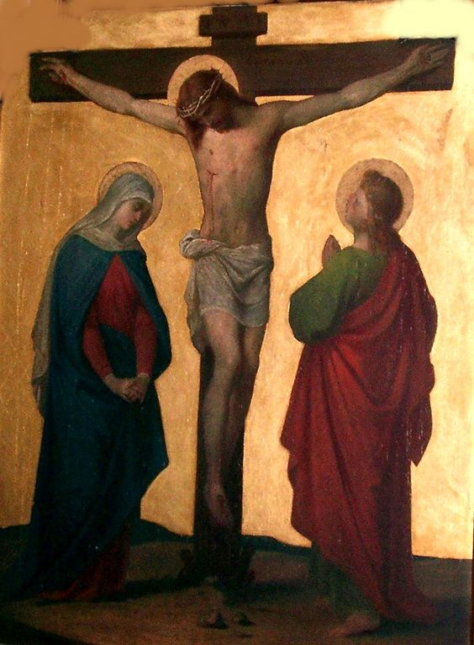
The Fourth Glorious Mystery:
The Assumption of Mary into Heaven
Dear Jesus, listening to your words as you hung upon the cross, blessed us with the gift of Mary, our Mother, and showed your unending love and concern for her.
Help me to listen to the suffering and dying; to be by their side now and at the hour of their death.
Synodality demands a profound stance of authentic listening from every believer.
John 19:26-27
When Jesus saw his mother* and the disciple there whom he loved,
he said to his mother, “Woman, behold, your son.”
Then he said to the disciple, “Behold, your mother.”

Slide 7
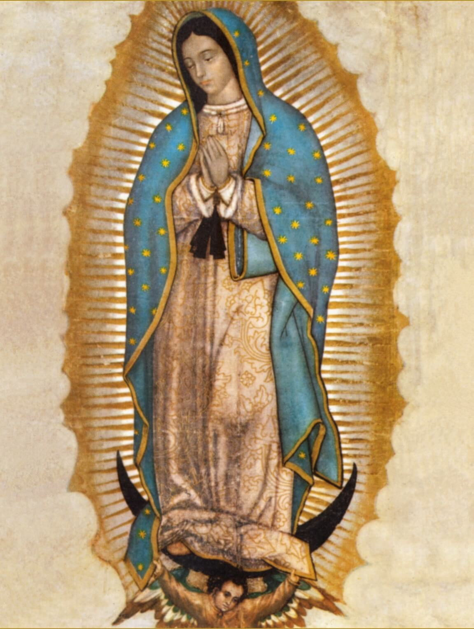
The Fifth Glorious Mystery:
Mary is Crowned as Queen of Heaven and Earth
O Queen of Heaven, you listen to my every need and place my prayers before your Son. Help me to be receptive of God’s will for me, as you so perfectly witnessed so humbly in your fiat.
A synodal church is a humble and honest church.
Luke 1:46-48
“My soul proclaims the greatness of the Lord;
my spirit rejoices in God my savior. For he has looked upon his handmaid’s lowliness;
behold, from now on will all ages call me blessed."

Slide 8
THE JOYFUL MYSTERIES

Slide 9
The First Joyful Mystery: The Annunciation
Holy Mary, through your intercession, and your model of humility, help me to learn to pause, pray, and listen, so I too will hear the call to bring Christ to others.
A synodal church is a humble and honest church.
Luke 1:26-27,30-31
…the angel Gabriel was sent from God … to a virgin betrothed to a man named Joseph, …
and the virgin’s name was Mary. Then the angel said to her,
“Do not be afraid, Mary, for you have found favor with God.
Behold, you will conceive in your womb and bear a son, and you shall name him Jesus.”

Slide 10
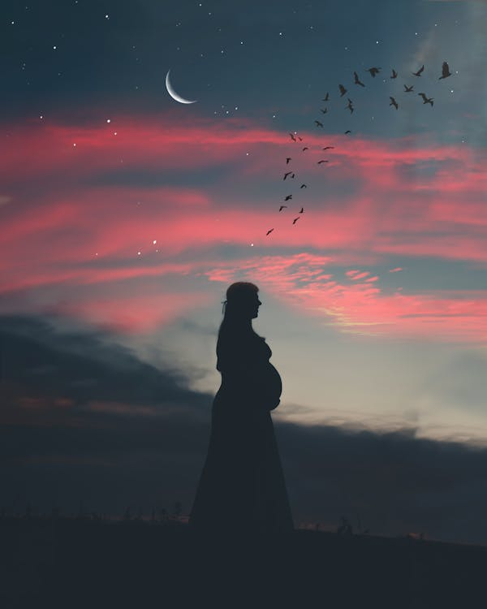
The Second Joyful Mystery: The Visitation
A synodal church is inclusive, embracing all, Todos, Todos, Todos.
Luke 1:39-42
During those days Mary set out and traveled to the hill country in haste to a town of Judah, where she entered the house of Zechariah and greeted Elizabeth.
When Elizabeth heard Mary’s greeting, the infant leaped in her womb, and Elizabeth,
filled with the holy Spirit, cried out in a loud voice and said,
“Most blessed are you among women, and blessed is the fruit of your womb.”
Dear Jesus, help me to listen to infants within the womb as attentively as Elizabeth did. Fill me with the Holy Spirit that I may safeguard each precious unborn child made in your image and likeness.

Slide 11
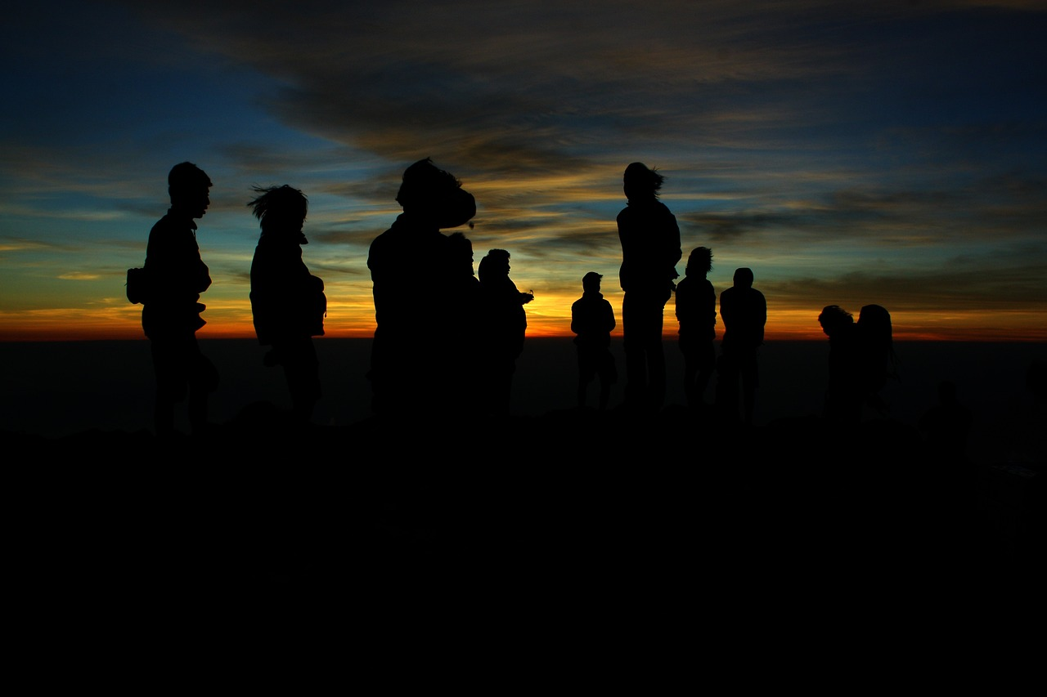
The Third Joyful Mystery: The Birth of Our Lord
A synodal church is a particular church when active involvement in the church is nurtured.
Luke 2:8-12, 16-17
Now there were shepherds in that region living in the fields and keeping the night watch over their flock. The angel of the Lord appeared to them and the glory of the Lord shone around them, and they were struck with great fear. The angel said to them, “Do not be afraid; for behold, I proclaim to you good news of great joy that will be for all the people.
For today in the city of David a savior has been born for you who is Messiah and Lord. And this will be a sign for you: you will find an infant wrapped in swaddling clothes and lying in a manger.” So they went in haste and found Mary and Joseph, and the infant lying in the manger.
When they saw this, they made known the message that had been told them about this child.
O Lord, help me to hear your call, as the shepherds did, to find Christ in unlikely, humble places. Help me to see my role to make known the message that Christ is in our midst.

Slide 12
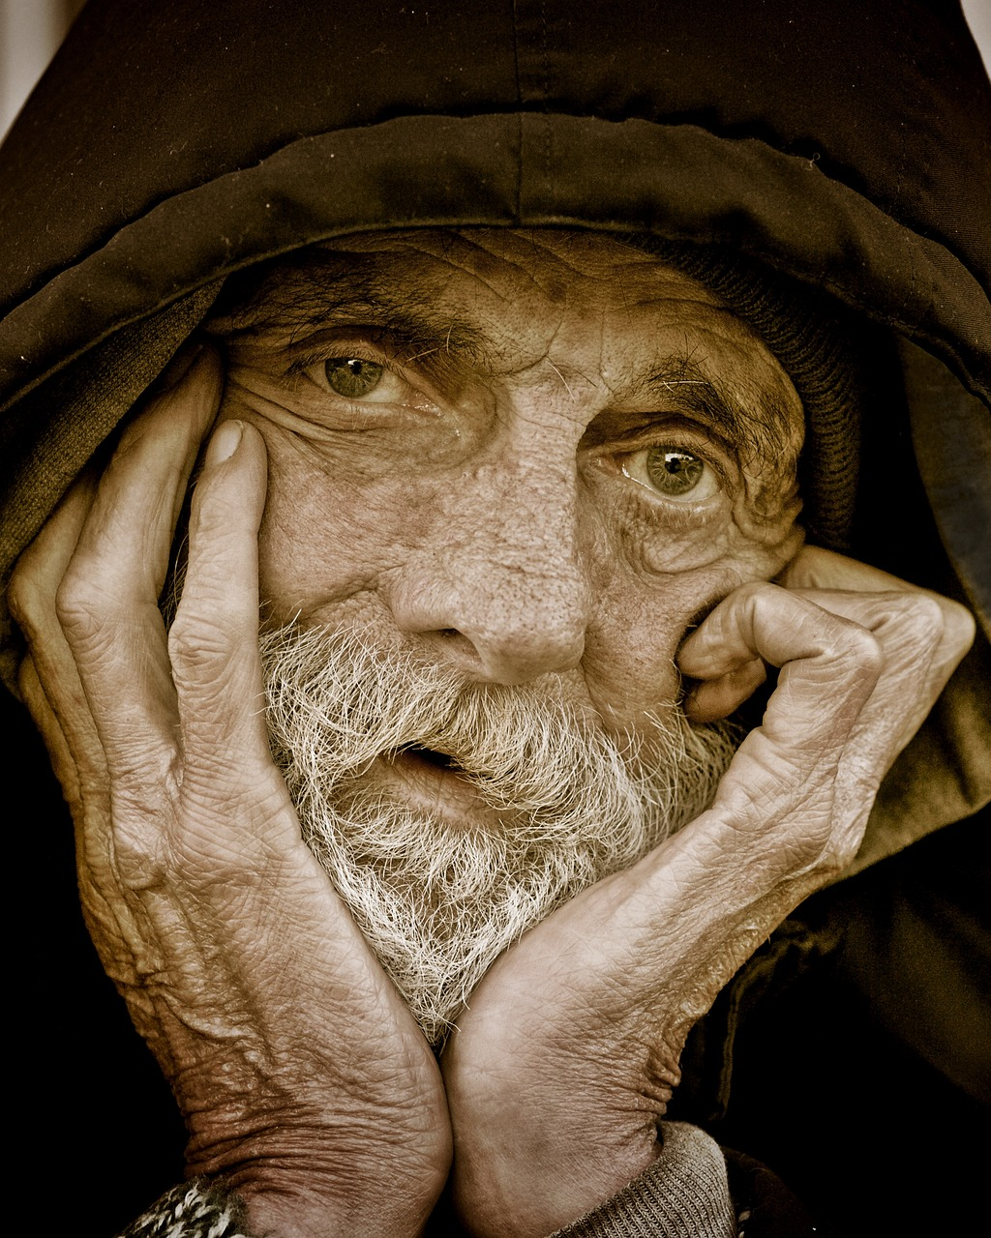
The Fourth Joyful Mystery: The Visitation
Synodality demands a profound stance of authentic listening from every believer.
Luke 2:22, 25-30=
[Mary and Joseph took Jesus] up to Jerusalem to present him to the Lord…. Now there was a man in Jerusalem whose name was Simeon…and when the parents brought in the child Jesus to perform the custom of the law… [Simeon] took him into his arms and blessed God, saying:
“Now, Master, you may let your servant go in peace, according to your word,
for my eyes have seen your salvation…”
Dear Jesus, help me to hear the cry of the elderly, the sick, and the lonely that are waiting for you to call them home. Help me to be like Mary and Joseph and bring your real presence to the homebound, hospitalized, and imprisoned so that their eyes may see your salvation.

Slide 13
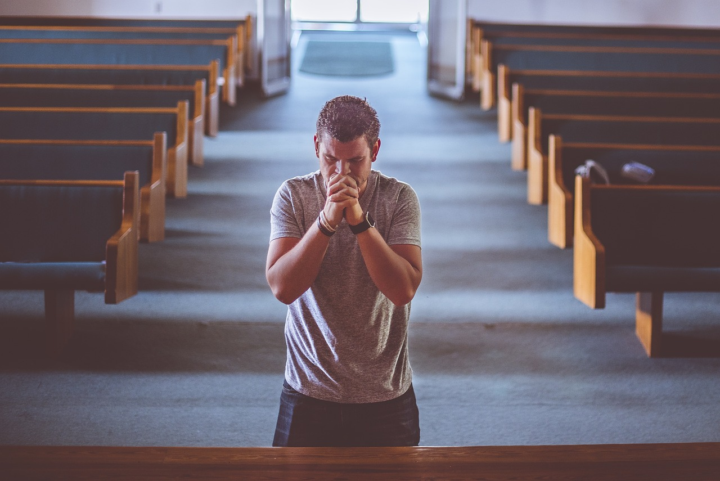
The Fifth Joyful Mystery: The Finding of Jesus in the Temple
Synodality seeks a church rooted in Word and Sacrament.
Luke 2:46-47 After three days [Mary and Joseph] found [Jesus] in the temple, sitting in the midst of the teachers, listening to them and asking them questions, and all who heard him
were astounded at his understanding and his answers.
Sweet Jesus, help me to hear your call to find you in Church, in the celebration of the Mass. Open my heart to encounter your Real Presence in the priest, the Word, The Eucharist and in the Assembly so that I may become what I receive and bring you to the world.

Slide 14
THE SORROWFUL
MYSTERIES

Slide 15
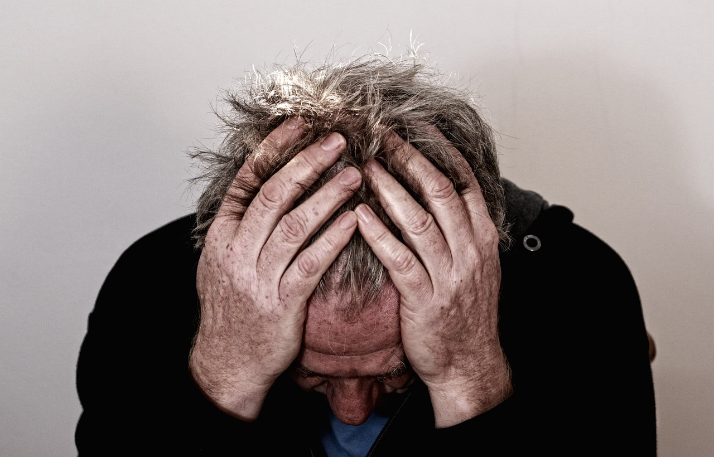
The First Sorrowful Mystery: The Agony in the Garden
Synodality demands a profound stance of authentic listening from every believer.
Matthew 25:37-49 He took along Peter and the two sons of Zebedee, and began to feel sorrow and distress.
Then he said to them, “My soul is sorrowful even to death. Remain here and keep watch with me.”
He advanced a little and fell prostrate in prayer, saying,
“My Father, if it is possible, let this cup pass from me; yet, not as I will, but as you will.”
When he returned to his disciples he found them asleep. He said to Peter,
“So you could not keep watch with me for one hour?”
Dear Lord, help me to remember that you are always there to listen to me even when I feel alone and desperate. Help me to stay vigilant and listen to others in their time of need.

Slide 16
The Second Sorrowful Mystery: The Scourging at the Pillar
A synodal church is a humble and honest church./
Matthew 27:26
Then Pilate released Barabbas to them, but after he had Jesus scourged,
he handed him over to be crucified.
As a disciple, I may be dealt words that will scourge me and inflict great pain upon me.
Jesus, help me to be like you and humbly bear the pain without striking back.

Slide 17
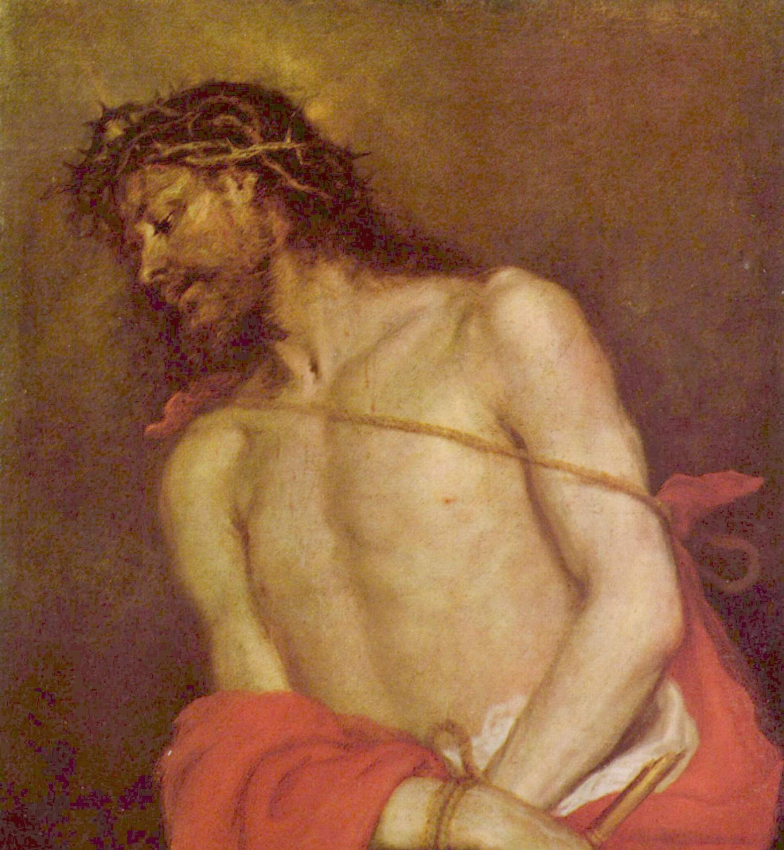
The Third Sorrowful Mystery: The Crowning with Thorns
A synodal church is a humble and honest church./
Matthew 27:29
Weaving a crown out of thorns, they placed it on his head, and a reed in his right hand.
And kneeling before him, they mocked him, saying, “Hail, King of the Jews!”
Jesus, you were mocked as the crowd jeered “Hail, King of the Jews” yet with great humility you bore the pain and did not respond. Help me to be humble like you and not retaliate when I hear words that mock and hurt me.

Slide 18
The Fourth Sorrowful Mystery: The Carrying of the Cross
A synodal church is a co-responsible church, where all members are welcomed
to service and leadership in light of their Baptism.
Mk 15:21-22 And they compelled a passer-by, Simon of Cyrene, who was coming in from the country, the father of Alexander and Rufus, to carry his cross. And they brought him to the place called Golgotha (which means the place of a skull).
Dear Lord, help me to listen to the cries of those that need help to carry their cross. Help me, so I will not turn away, but instead bear their burden, like Simon of Cyrene bore the cross for you.

Slide 19
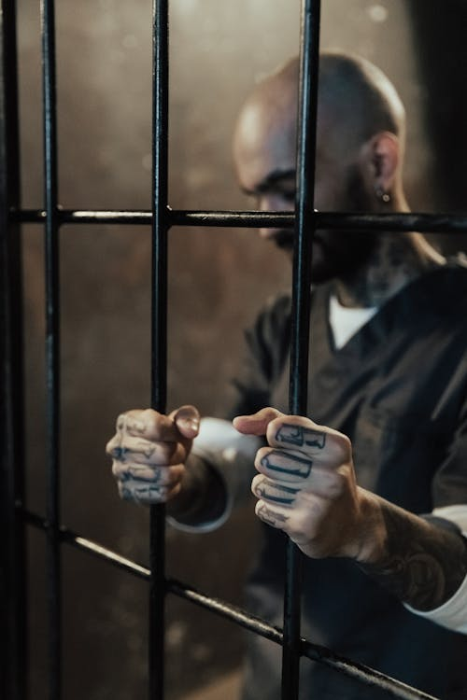
The Fifth Sorrowful Mystery: The Crucifixion
Jesus, you listened to the pleas of the good thief even when you were in dire distress. Help me to listen to the cries of the imprisoned and the suffering. Help me to respond to their needs even when I am in pain.
A synodal church is inclusive, embracing all, Todos, Todos, Todos.
Luke 23:42-43
One of the criminals hanging next to Jesus said,
“Jesus, remember me when you come into your kingdom.”
Jesus replied, “Amen, I say to you, today you will be with me in Paradise.”

Slide 20
THE LUMINOUS MYSTERIES

Slide 21
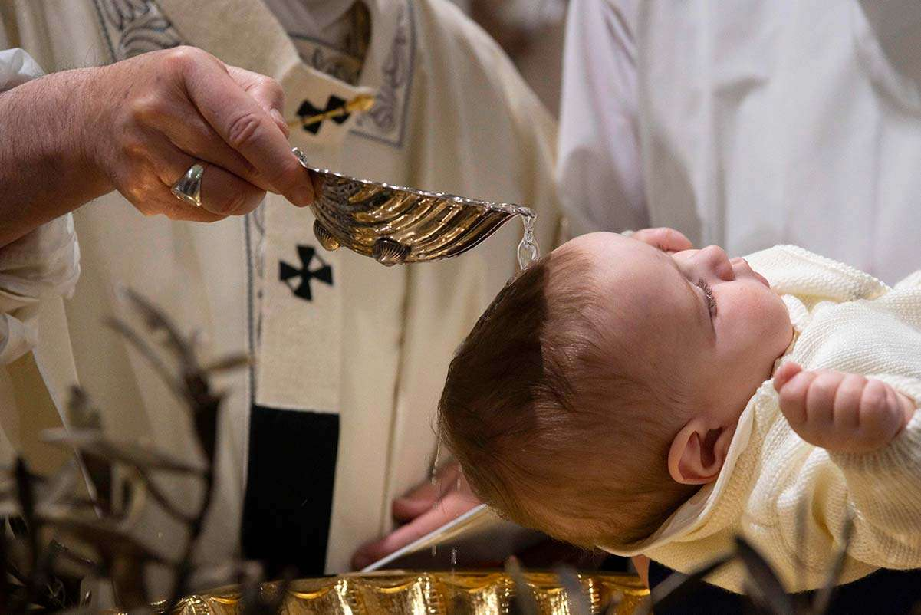
The First Luminous Mystery:
The Baptism in the Jordan
Dear Jesus, help me to remember that through my Baptism I have been anointed priest, prophet, and king to minister to those in need, proclaim the good news, and to be a servant leader.
A synodal church is a co-responsible church, where all members
are welcomed to service and leadership in light of their Baptism.
Luke 3:21-22
After Jesus also had been baptized and was praying, heaven was opened and the holy Spirit descended upon him in bodily form like a dove. And a voice came from heaven,
“You are my beloved Son; with you I am well pleased.”

Slide 22
The Second Luminous Mystery:
The Wedding at Cana
Hail Mary, full of grace,
through your intercession may I be filled with the grace I need to respond to your prompting to do whatever Jesus tells me.
A synodal church is a particular church when active involvement in the church is nurtured. .
John 2: 3-5
When the wine ran short, the mother of Jesus said to him, “They have no wine.” [And] Jesus said to her, “Woman, how does your concern affect me? My hour has not yet come.”
His mother said to the servers, “Do whatever he tells you.”

Slide 23
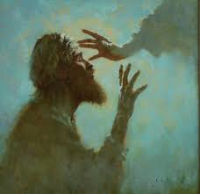
The Third Luminous Mystery:
The Proclamation of the Kingdom
Dear Jesus, help me to listen to the proclamation of the Holy Gospel in Mass with an open heart so that your Word may be fulfilled in my hearing.
Synodality seeks a church rooted in Word and Sacrament.
Luke 4:18,19,21
“The Spirit of the Lord is upon me, because he has anointed me to bring glad tidings to the poor. He has sent me to proclaim liberty to captives and recovery of sight to the blind to let the oppressed go free, and to proclaim a year acceptable to the Lord.” …
He said to them, “Today this scripture passage is fulfilled in your hearing.”

Slide 24
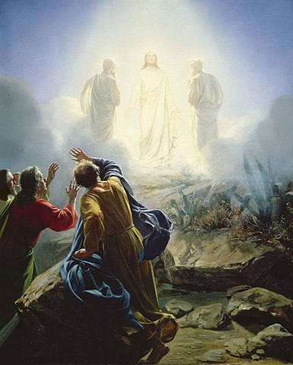
The Fourth Luminous Mystery:
The Transfiguration
My Lord and my God, help me to see that the suffering here on earth is but temporary. You are the Way, the Truth, and the Life, leading us on our journey toward the kingdom.
A synodal church sees itself as the pilgrim people of God,
constantly on journey toward the kingdom.
Matthew 17:5
…from the cloud came a voice that said,
“This is my beloved Son, with whom I am well pleased; listen to him.”

Slide 25
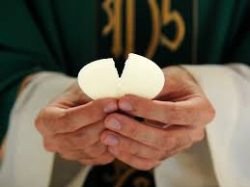
The Fifth Luminous Mystery:
The Institution of the Eucharist
Dear Jesus, help me to listen closely to the words of consecration. Deepen my faith in your Real Presence in the Eucharist. Help me to be your hands, your voice, and your love in the world.
Synodality seeks a church rooted in Word and Sacrament.
Luke 22:19
He took the bread, said the blessing, broke it, and gave it to them, saying, “This is my body, which will be given for you; do this in memory of me.”

